Slide 1

Alex Eng, Stephen Phillips

Slide 2

Information Hiding
Encapsulation
Inheritance
Polymorphism
You know these, but these form the basis for the other principles

Slide 3

Single Responsibility Principle
Open Closed Principle
Liskov Substitution Principle
Interface Segregation Principle
Dependency Inversion Principle
Other principles:
  Law of Demeter
Notes:
--Every one of these principles is designed to help control change
--If one thing changes, it’s hard to see all the effects on other parts of the software. So controlling change is a big issue

Slide 4

Definition: There should never be more than one reason for a class to change.
Enforces small classes that are easier to maintain
Decreases coupling between functionalities by containing all of a single responsibility in one class
Notes:
--One of the simpler rules, but one of the most hard to enforce – easy to group related functionalities together
--If a class changes, and the classes that depend on it have to rememeber what to change, and if there is more than one reason for it to change, unexpected errors pop up

Slide 5
Example: In a drawing application
GraphicalRectangle
+ draw(): void
Rectangle
+ draw(): void
+ area(): double
GeometricRectangle
+ area(): double
Notes:
--It seems natural to have the Geometric representation of a rectangle and the functionality to draw it put together
--Problem is if the way objects are drawn OR if the way a Rectangle is graphically represented chages, so does this class
---MORE THAN ONE REASON TO CHANGE!

Slide 6

Definition: Software entities should be open for extension, but closed for modification.
This means creating flexible designs where the parts most likely to change are encapsulated

Slide 7
Example: Using a food interface for a restaurant application to allow new kinds of food
<<Interface>>
Food
+ prepare(): void
+ deliver(): void
Pizza
Hamburger
French Fries
PepperoniPizza
Cheeseburger
Notes:
--Subclassing is a great way to conform to the open closed principle

Slide 8
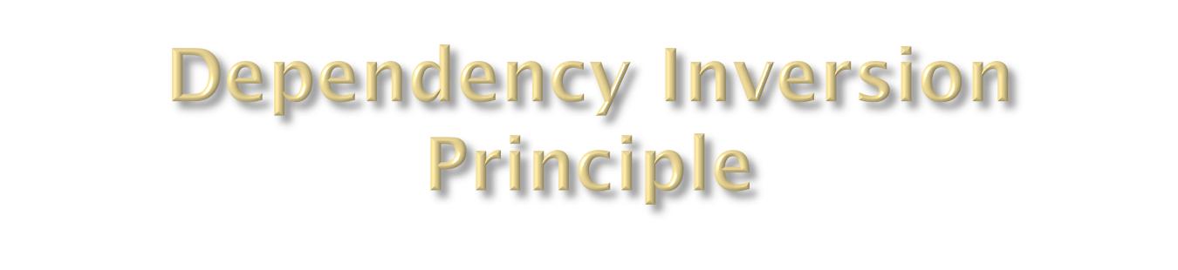
Definition: High level modules should not depend upon low level modules. Both should depend upon abstractions.
Abstractions should not depend upon details. Details should depend upon abstractions.
Notes:
--Not using abstractions leads to fragile code that can’t change
--This makes classes not implementation dependent

Slide 9
Example: wrapping your low level modules in an interface will make it easier to change and read.
<<Interface>>
Client
ConcreteClient
Client
+ doStuff(): void
+ doStuff(): void
+ doStuff(): void
<<Interface>>
Device
Device
ConcreteDevice
+ action(): void
+ action(): void
+ action(): void
Notes:
--This way you can change the device without having to change the client code

Slide 10

Definition: An object can manipulate data of:
  Itself
  Objects that compose it
  Objects passed into it
  Objects it creates
Prevents depending too much on it’s implementation

Slide 11
Bad example:
  obj.getA().getB().executeC()
Good example:
  obj.executeBC()
Notes:
--This way you don’t have to know all the insides of obj in order to use that executeC

Slide 12

A brief review
Notes:
--It’s good to get what coding conventions you will be using before you set – that way everyone is on the same page and makes the code easier to read and maintain

Slide 13

Functions should do only one thing
  Similar to classes
Make your logic clear
Stick to the DRY Principle
  Don’t Repeat Yourself
Notes:
--These principles help others read your code
---If a function does 3 different things, it’s harder to follow your logic
---If there are side effects in your function, it’s much harder to track down bugs
---If you logic is convoluted, then others won’t read it well
---DRY Priciple also makes things easier to read (less to read) and makes less bugs (if a bug is in one place, it is ONLY in one place)

Slide 14

Two schools of thought: Exceptions and Error codes
Exceptions:
Can lead to less lines of code to deal with error handling
Error handling can be dealt with all in one place
If done correctly, less coupling to the error handling
Error Codes:
Better performance
Easier to handle for small errors
Notes:
--Most of the time exceptions tend to work better -> you really have to catch them though
(Bad examples of unhandled exceptions)

Slide 15


Slide 16
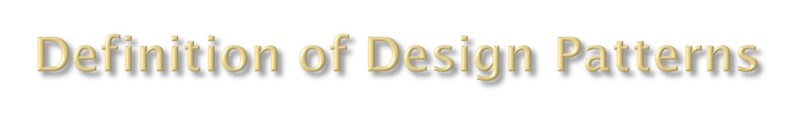
A solution to a recurring problem in a context
Design patterns are more high level than libraries but lower level than merely concepts
Design patterns are motivated by goals and constraints

Slide 17

Create an interface for a family of algorithms
Have different objects for each algorithm, each of those objects implements the interface for the family
Other objects can now have a reference to an object in the family of algorithms
You can set the specific object (and thus algorithm) from the family at runtime

Slide 18
StrategyClass
<<Interface>>
Behavior
ConcreteBehavior1
ConcreteBehavior2

Slide 19
Example: Weapons and characters in a game
class Ax
{
// All the lovely things about an ax
void swingAx()
{
// Stuff to make ax swing
}
}
class Knife
{
// All the lovely things about an knife
void stabKnife()
{
// Stuff to make knife stab
}
}
// ...
class Character
{
// ...
public attack(String type)
{
switch(type) {
case "Ax":
swingAx()
break
case "Knife":
stabKnife()
break
}
}
}
Notes:
--It’s easy to see that this isn’t very well designed for extension
--If a new kind of weapon is added to the game, then the switch statement must be modified
--If there is more than one switch statement in the code, we have to remember to change all of them

Slide 20
/// BETTER ///
Interface class Weapon
{
public def attack();
}
class Ax implements Weapon
{
// All the lovely things about an ax
def attack()
{
// Stuff to make ax swing
}
}
class Knife implements Weapon
{
// All the lovely things about an knife
void attack()
{
// Stuff to make knife stab
}
}
//...
class Character
{
private Weapon weapon;
// ...
public attack()
{
weapon.attack()
}
}
Notes:
--Clearly polymorphism is better here.
--If you every see a switch statement, or if-else chain, it might be better replaced by polymorphism

Slide 21

Class that simplifies complex method calls for other methods and objects to use

Slide 22
LargeClass
FacadeClass
+ execute(): void
ConcreteClass1
ConcreteClass2
+ thing1(): void
+ thing2(): void
+ function1(): void
+ function2(): void

Slide 23
Example: Initializing a game level
Class Level
{
//...
}
Class Camera
{
//...
}
Class GameWorld
{
//...
}
Class Character
{
//...
}
Class GameStarter
{
def start() {
final Level Level1 = //...
GameWorld gameWorld = new GameWorld()
gameWorld.setLevel(Level1)
gameWorld.initializeMonsters()
Camera camera = new Camera()
camera.setPosition(initialPosition)
}
}

Slide 24

Implement the interface of what you are adapting to
Reference to object you are adapting
Implement methods in the interface

Slide 25
<<Interface>>
InterfaceClass
ConcreteClass
AdapterClass
AdaptedClass

Slide 26
Example: Using third party code with your own
<<Interface>>
Phone
+ callPhone(): void
+ getPhoneNumber(): int
CellPhone
HomePhone
InternetPhone
Adapter
Internet Phone
+ getIpAddress(): int
+ callPhoneOrUser(): void

Slide 27

Create an interface for an object that can “visit” referenced objects in a larger class
The interface defines a visit method for each smaller object encapsulated in the larger object
Classes that implement the interface then implement the visit method for each smaller object

Slide 28

The larger object can then have a reference to an object of the visitor interface and use it to perform the visit method upon its smaller referenced objects
Allows the larger object to not contain methods for manipulating its encapsulated objects
The particular visitor being used can be changed at runtime

Slide 29
Client
<<Interface>>
Visitor
+ visit(ConcreteElement: Object)
ElementStructure
ConcreteVisitor1
ConcreteVisitor2
<<Interface>>
Element
+ accept(Visitor: Object)
ConcreteElement

Slide 30
Example: Running all the rides at a theme park
interface Ride {
void accept(RideVisitor rideVisitor)
//...
}
class RollerCoaster implements Ride {
void accept(RideVisitor rideVisitor) {
rideVisitor.visit(this)
}
//...
}
class LogRide implements Ride {
void accept(RideVisitor rideVisitor) {
rideVisitor.visit(this)
}
//...
}

Slide 31
interface RideVisitor {
void visit(RollerCoaster rollerCoaster)
void visit(LogRide logRide)
}
class RideStarter implements RideVisitor {
void visit(RollerCoaster rollerCoaster) {
//...
}
void visit(LogRide logRide) {
//...
}
}

Slide 32


Slide 33

Functions as objects
Can be passed as arguments and returned from method calls
In Groovy, can turn methods into closure instances using the .& operator

Slide 34
{ x -> x + 3 }
{ 24 + 18 }
{x, y, z -> x + y * z}
def method = SomeClass.&someMethod

Slide 35

Can apply a function to each element in a list because you expect no side effects to affect the list or other elements in the list
Groovy allows you to apply a closure to each element in a list with the .each method of the list

Slide 36
List.each { item -> f(item) }
Map.each { key, value -> g(key, value) }

Slide 37

Take function of X parameters and split it up into X functions of one parameter each
Each function takes in parameter N of the original function, sets the value of parameter N, and then returns the function that takes in parameter N+1

Slide 38

The function that takes in parameter N = X will then have had all of the parameters set and thus can perform the operations of the original function
Groovy closures have a curry() method, binds parameters from left to right

Slide 39
3*X + 2*Y*Z
  X, Y, Z -> 3*X + 2*Y*Z
  X -> { Y, Z -> { 3*X + 2*Y*Z } }
  X -> { Y -> { Z -> { 3*X + 2*Y*Z } } }
In Groovy, you can do the following:
  def closure = {x, y, z -> x + y * z}
  def curriedClosure = closure.curry(2)
  curriedClosure is equivalent to {y, z -> 2 + y * z}

